Slide 1
Liberated Ethnic Studies Model Curriculum Consortium
We ask that you give LESMCC credit for any portion OF THIS LESSON OR ITS ACCOMPANYING SLIDES used and that you respect the intended use of the material. ENJOY!

Slide 2
Who Are Arab Americans?: An Introduction
Notes:
Explain that the purpose of this lesson is for students to have a better understanding of who Arab Americans are. This is meant to be an introduction only. Pass out the student note taker to each student or provide access to it as a force copy for each student to utilize throughout the lesson.

Slide 3
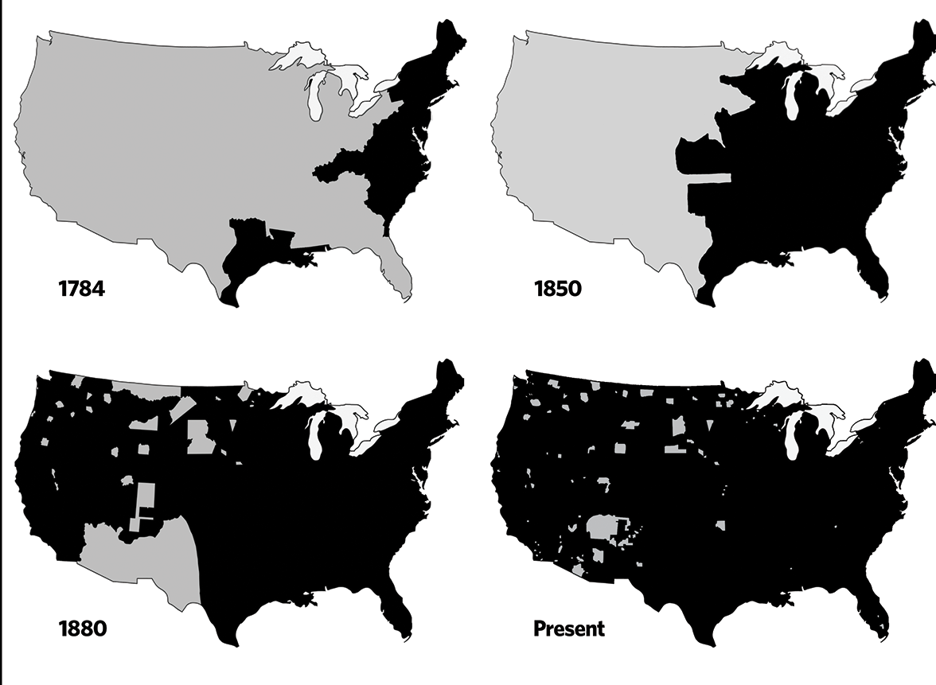
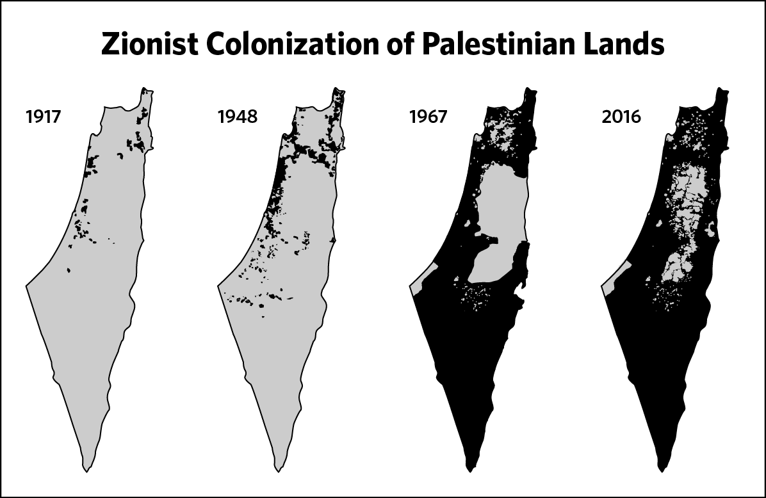
Land
Acknowledgement
WE ACKNOWLEDGE the land and the people to whom this land belongs. This is the land of the ________ people, and they are still here.
WE STAND in solidarity with ALL indigenous people and their right to self-determination, liberation and peace.
WE COMMIT to working toward the healing of generational trauma, theft and dispossession that native and indigenous people have faced and continue to face.
In this light, MY PLEDGE today is to….
Indigenous land loss from 1784-present
Palestine land loss 1917-2016.

Slide 4
Ancestor
Acknowledgement
Said wrote extensively about the West's misrepresentations of the Arab cause. In 1979, in an essay "Zionism from the Standpoint of its Victims," Said argued in favor of the political legitimacy and right to a Jewish homeland; but also on the right of the Palestinians for self-determination.
In an essay published in The Nation in 1980, "Islam through Western Eyes," Said wrote, "Very little of the detail, the human density, the passion of Arab-Moslem life has entered the awareness of even those people whose profession it is to report the Arab world. What we have, instead, is a series of crude, essentialized caricatures of the Islamic world, presented in such a way as to make that world vulnerable to military aggression."
Born: Edward Wadie Said
1 November 1935
Mandatory Palestine
Died: 24 September 2003 (aged
67)
New York City, New York, U.S.
Notes:
Share the ancestor acknowledgement.
Taken from this opinion piece written by Cesar Chelala: https://www.commondreams.org/views/2019/04/10/edward-said-remembering-palestinian-patriot

Slide 5
Who are Arab Americans?
Cultural Energizer

Slide 6
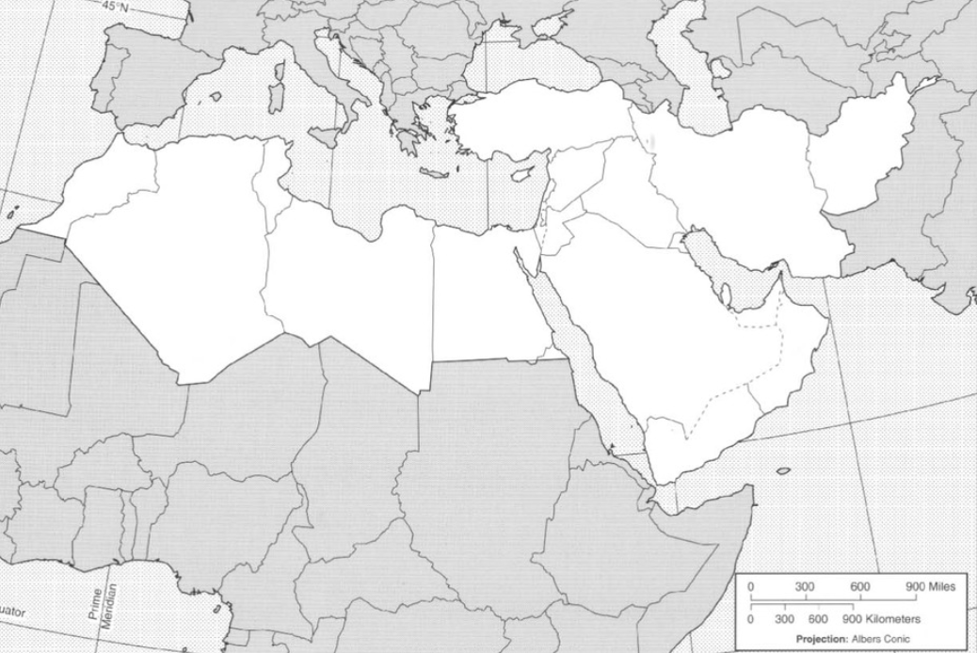
Locate any countries that you think are part of the Arab world.
Notes:
Direct students: Locate any countries that are part of the Arab world.

Slide 7
Where and what is the Arab World?
The Arab world is often defined by membership in the League of Arab States (also known as The Arab League), which consists of 22 countries: Egypt, Algeria, Morocco, Sudan, Iraq, Saudi Arabia, Yemen, Syria, Tunisia, Somalia, United Arab Emirates, Libya, Jordan, Lebanon, the Palestinian Authority, Mauritania, Kuwait, Oman, Qatar, Bahrain, Djibouti and Comoros Islands (listed in order of size of population).
Most of these countries consider Arabic their national language, although they may have substantial non-Arabic speaking populations. Even if they speak English fluently, attachment to the Arabic language as their native tongue is one of the cultural aspects that Arab Americans, particularly more recent immigrants, share.
Notes:
Share the description.
Arab American National Museum

Slide 8
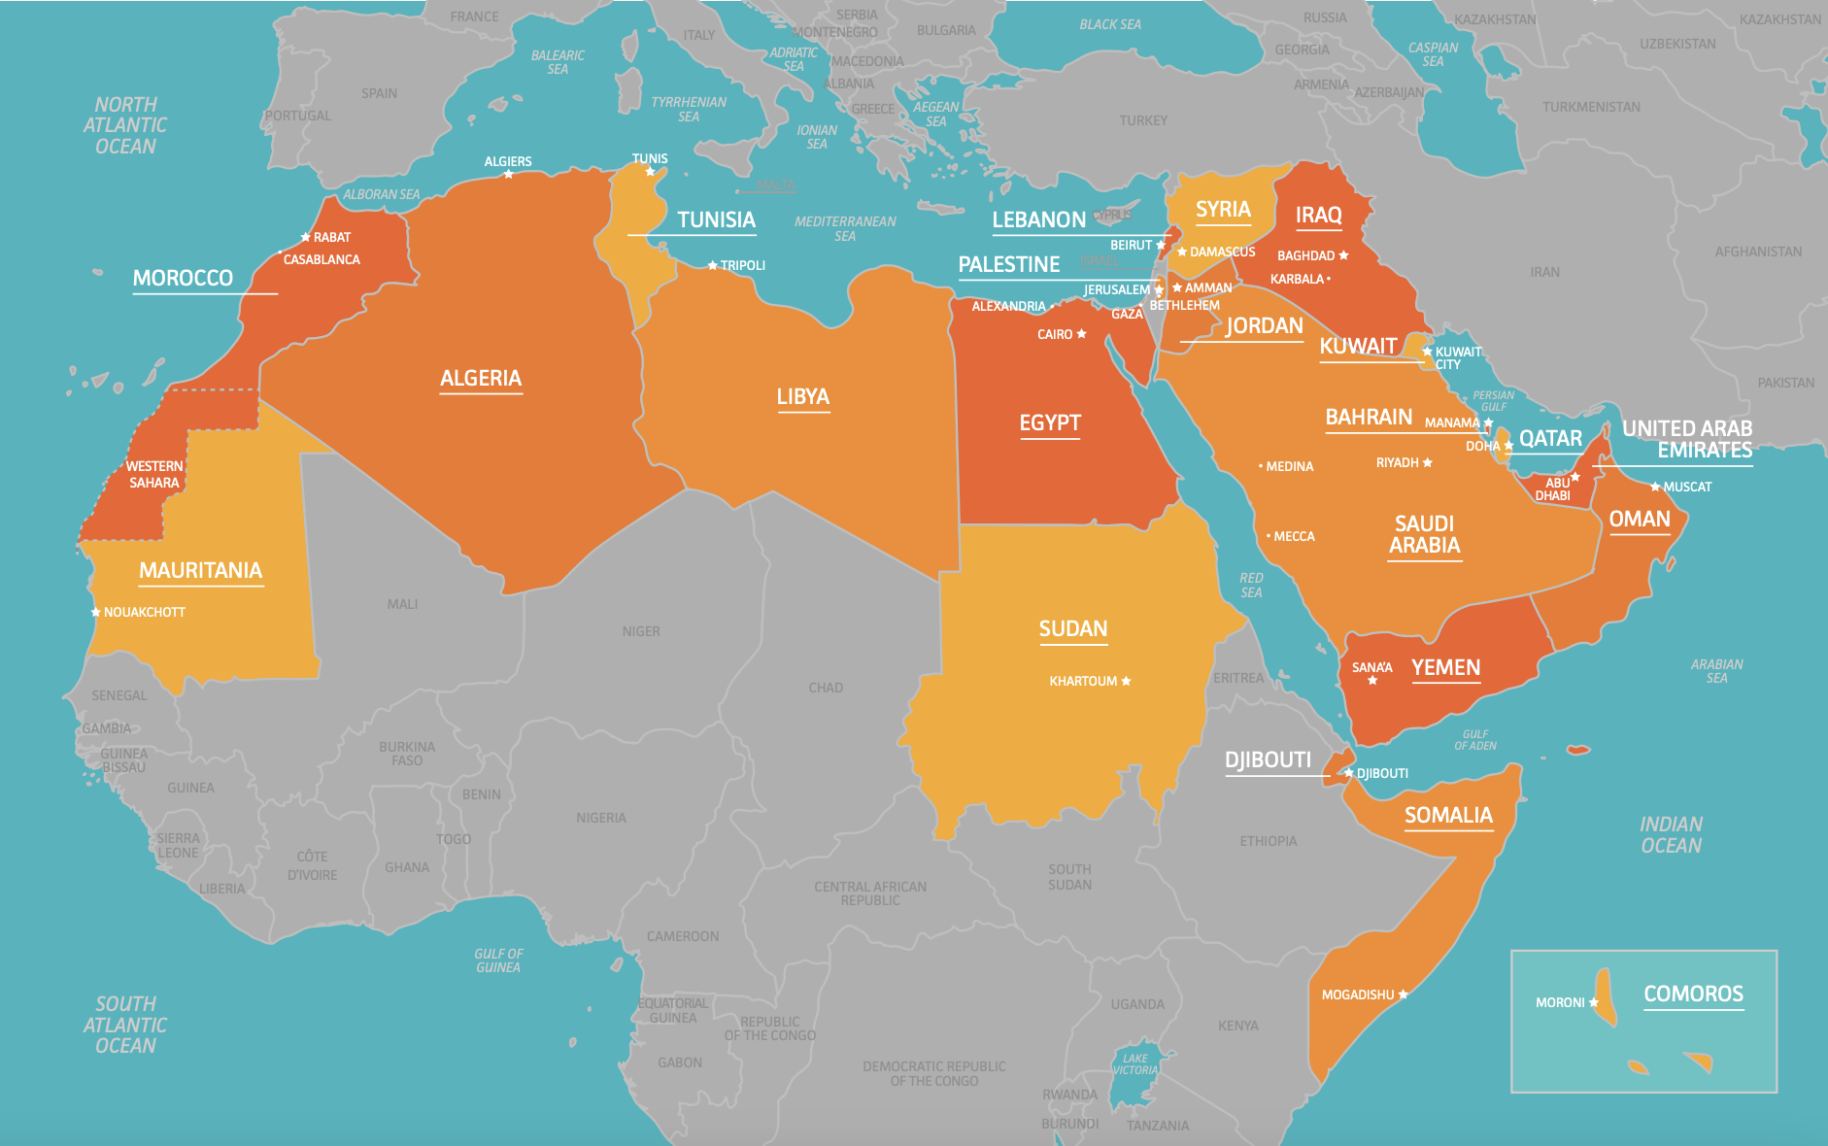
What do you notice about the countries that are part of the Arab world? Is anything surprising to you?
Notes:
Share and discuss.
Arab American National Museum

Slide 9
How is the Arab World different from the Middle East?
While many in the U.S. tend to use the terms “Middle East” and “Middle Eastern” casually, it is not fully interchangeable with the more specific term Arab.
Although both geographic-cultural terms are debatable, the Middle East includes countries that are not considered Arab, including Iran, Turkey and Cyprus.
Rather than identifying their main national language as Arabic, people in these countries speak Farsi, Turkish, Cypriot Turkish and Cypriot Greek, respectively.
The State of Israel is included in the Middle East, where Modern Hebrew and Arabic are the two official languages.
In addition, African Arab countries are often not placed in the Middle East and are categorized either as separate countries or by their location within the African continent.
Notes:
Share the differences.
Arab American National Museum

Slide 10
How is the Arab World different from the Middle East?
The reasons behind the unclear terminology lie in history and changes in Western colonial perceptions of the region.
Early European geographers divided the East — broadly meaning the Asian continent — into the Near East (the area extending from the Mediterranean to the Arabian Gulf), the Middle East (from the Arabian Gulf to Southeast Asia) and the Far East (the region facing the Pacific Ocean).
In the 20th century, these traditional delineations changed when the Ottoman Empire broke up and the British military command in World Wars I and II began to claim that areas in both the Near East and the Middle East were part of their “Middle East command.”
The term Middle East slowly began to refer to the whole region in general, but which exact areas were included is subject to interpretation and context.
Notes:
Share the differences.
Arab American National Museum

Slide 11
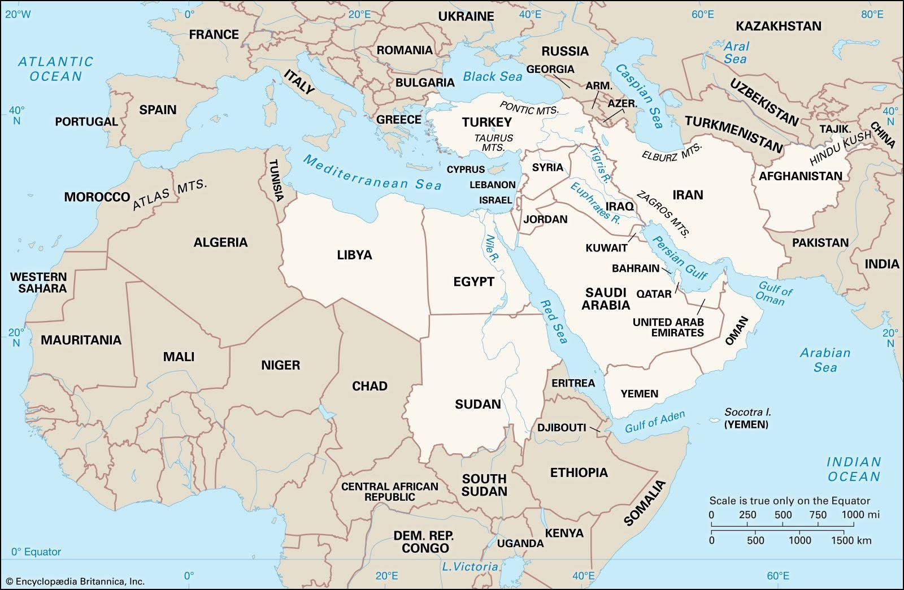
Arab world
Middle East
Notes:
The Middle East is a loose term, not always used to describe the same territory. It usually includes the Arab countries from Egypt east to the Persian Gulf, plus Israel and Iran. Turkey is sometimes considered part of the Middle East, sometimes part of Europe.Arab Americans are Americans of Arab descent. There are Americans with roots in each Arab country, but most originate from Lebanon, Syria, and Palestine. There are also substantial communities from Egypt, Yemen and Iraq. The first immigrants arrived in the late 19th century. A second wave of immigration started after World War II, and still continues. The largest communities of Arab Americans live in the Detroit-Dearborn area.
https://adc.org/facts-about-arabs-and-the-arab-world/#:~:text=The%20Middle%20East%20is%20a,East%2C%20sometimes%20part%20of%20Europe
Arab American National Museum
Encyclopedia Britannica

Slide 12
True or False?
Critical Concepts

Slide 13
True or False:
Most Muslims in the U.S. are Arab American.
FALSE. Although many people think “Muslim” equals “Arab” (and vice versa), the majority of U.S. Muslims are not people of Arab descent. Arab Americans constitute only 12% of this country’s Muslim population. The bulk of U.S. Muslims are African American (42%), while immigrants of South Asian descent comprise almost 24% of American Muslims. There are also 80,000 people of Western European heritage who practice Islam. Further, a large number of Arab Americans are Christian. Between the latter part of the 19th century and World War II, a multitude of Christians left Syria and Lebanon and came to America. These immigrants (and their descendents) represent roughly 70-75% of Arab Americans today.
Notes:
Pose the true/false questions to students and ask for volunteers to share their answers with evidence. For example, “I think this statement is (true/false) because __________.” Following student sharing, reveal the answer and either read or invite a volunteer to read the answer. Direct students to take notes.
https://www.learningforjustice.org/sites/default/files/documents/arab_americans_all.pdf

Slide 14
True or False:
Arab Americans live mostly in urban areas.
TRUE: Arab immigrants began coming to the U.S. in sizable numbers during the 1880’s. Today, it is estimated that nearly 3.7 million Americans trace their roots to an Arab country. Arab Americans are found in every state, but more than two thirds of them live in just ten states: California, Michigan, New York, Florida, Texas, New Jersey, Illinois, Ohio, Pennsylvania, and Virginia. Metropolitan Los Angeles, Detroit, and New York are home to one-third of the population.
Notes:
Pose the true/false questions to students and ask for volunteers to share their answers with evidence. For example, “I think this statement is (true/false) because __________.” Following student sharing, reveal the answer and either read or invite a volunteer to read the answer. Direct students to take notes.
https://www.learningforjustice.org/sites/default/files/documents/arab_americans_all.pdf

Slide 15
True or False:
Most Arab Americans speak a language other than English in their homes.
TRUE: Fifty-one percent of Arab Americans speak a language other than English in their homes. The vast majority, however, are bilingual. Only 8% of Arab American school-age children speak little or no English.
Notes:
Pose the true/false questions to students and ask for volunteers to share their answers with evidence. For example, “I think this statement is (true/false) because __________.” Following student sharing, reveal the answer and either read or invite a volunteer to read the answer. Direct students to take notes.

Slide 16
Arab American Immigration Stories:
Community Collaboration
Notes:
View the stories with the class and ask student to think about why each person/family came to the United States.
https://www.youtube.com/watch?v=1QgWRRHOgi8&list=PLWMcFlNbo_MPIXHF8o32PEq2sqCy-EojG&index=1
https://www.youtube.com/watch?v=9pOPSmY4mK8&list=PLWMcFlNbo_MPIXHF8o32PEq2sqCy-EojG&index=10

Slide 17
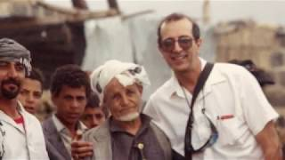
Immigration Stories
View the stories and take notes on why each person/family came to the United States.
Yemen to US
Notes:
View the stories with the class and ask student to think about why each person/family came to the United States.
https://www.youtube.com/watch?v=1QgWRRHOgi8&list=PLWMcFlNbo_MPIXHF8o32PEq2sqCy-EojG&index=1

Slide 18
Immigration Stories
View the stories and take notes on why each person/family came to the United States.
Sudan to US
Notes:
View the stories with the class and ask student to think about why each person/family came to the United States.
https://youtu.be/CrjZEbKK4ak?si=c2pRMXFttS9jgfzR

Slide 19
Immigration Stories
View the stories and take notes on why each person/family came to the United States.
Lebanon to US
Notes:
View the stories with the class and ask student to think about why each person/family came to the United States.
https://youtu.be/bHHU60c5vPc?si=EcAr4SdYMWWyNjF1

Slide 20
Conclusive Dialogue:
Reasons for Immigration
Notes:
After viewing the immigration stories, ask students to share the reasons that the different Arab Americans shared that they immigrated to the United States and write in these charts. Then have them write a personal reflection on how their understanding of Who Arab Americans are has changed.

